Slide 1
Chapter 18
The Pentium and Pentium Pro Microprocessors

Slide 2
The Pentium Microprocessors

Slide 3
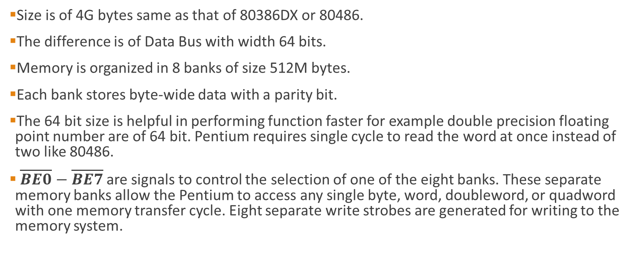
The Memory System
Size is of 4G bytes same as that of 80386DX or 80486.
The difference is of Data Bus with width 64 bits.
Memory is organized in 8 banks of size 512M bytes.
Each bank stores byte-wide data with a parity bit.
The 64 bit size is helpful in performing function faster for example double precision floating point number are of 64 bit. Pentium requires single cycle to read the word at once instead of two like 80486.
$\overline{BE0}$ $− \overline{BE7}$are signals to control the selection of one of the eight banks. These separate memory banks allow the Pentium to access any single byte, word, doubleword, or quadword with one memory transfer cycle. Eight separate write strobes are generated for writing to the memory system.

Slide 4
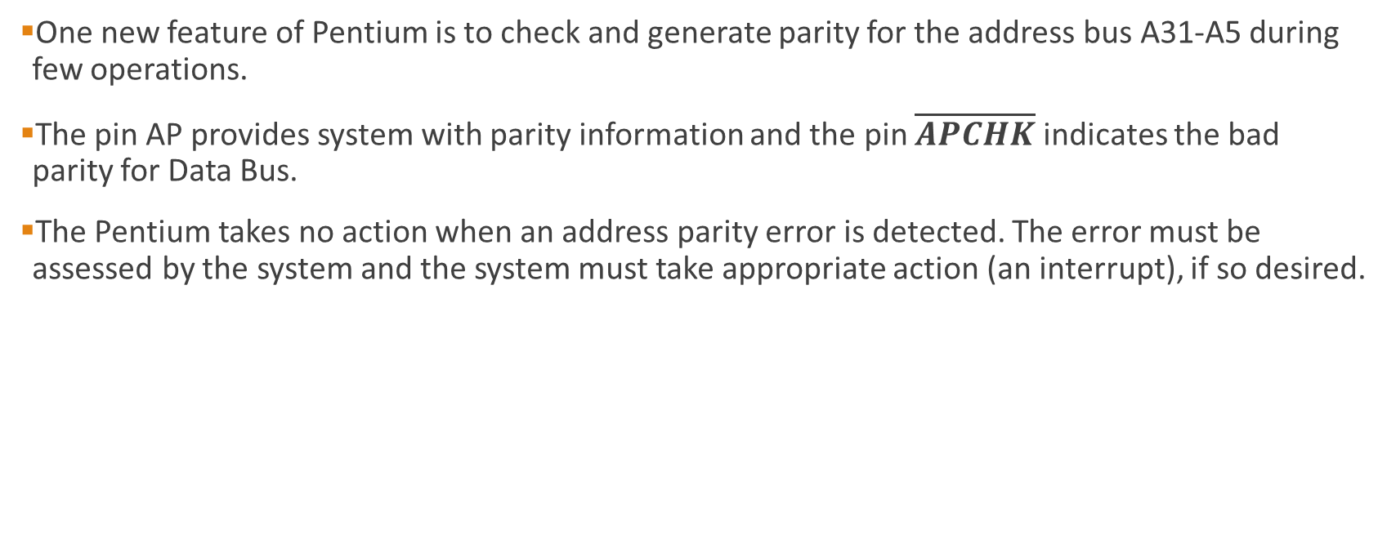
One new feature of Pentium is to check and generate parity for the address bus A31-A5 during few operations.
The pin AP provides system with parity information and the pin $\overline{APCHK}$ indicates the bad parity for Data Bus.
The Pentium takes no action when an address parity error is detected. The error must be assessed by the system and the system must take appropriate action (an interrupt), if so desired.

Slide 5
Input/Output System
Compatible with earlier Intel Microprocessors.
The I/O port number appears on address lines A15–A3 with the bank enable signals used to select the actual memory banks used for the I/O transfer.
In case of blocked I/O location is accessed a type 13 interrupt will occur to signal an I/O privilege Violation.

Slide 6
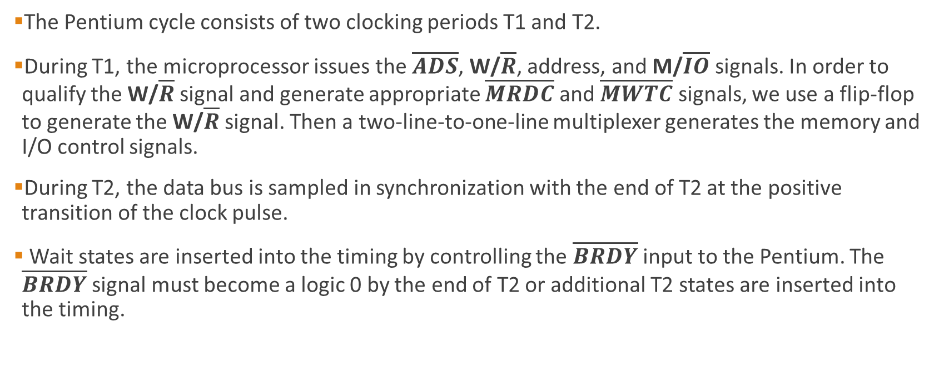
System Timing
The Pentium cycle consists of two clocking periods T1 and T2.
During T1, the microprocessor issues the $\overline{ADS}$, W/$\overline{R}$, address, and M/$\overline{IO}$ signals. In order to qualify the W/$\overline{R}$ signal and generate appropriate $\overline{MRDC}$ and $\overline{MWTC}$ signals, we use a flip-flop to generate the W/$\overline{R}$ signal. Then a two-line-to-one-line multiplexer generates the memory and I/O control signals.
During T2, the data bus is sampled in synchronization with the end of T2 at the positive transition of the clock pulse.
Wait states are inserted into the timing by controlling the $\overline{BRDY}$ input to the Pentium. The $\overline{BRDY}$ signal must become a logic 0 by the end of T2 or additional T2 states are inserted into the timing.

Slide 7
A more efficient method of reading memory data is via the burst cycle.
The burst cycle in the Pentium transfers four 64-bit numbers per burst cycle in five clocking periods.
A burst without wait states requires that the memory system transfers data every 15.2 ns.
If a level 2 cache is in place, this speed is no problem as long as the data are read from the cache.
If the cache does not contain the data, then wait states must be inserted, which will reduce the data throughput

Slide 8
Branch Prediction Logic
Pentium uses branch prediction logic to reduce the time required for a branch caused by internal delays.
These delays are minimized because when a branch instruction (short or near only) is encountered, the microprocessor begins prefetch instruction at the branch address.
The instructions are loaded into the instruction cache, so when the branch occurs, the instructions are present and allow the branch to execute in one clocking period.
If for any reason the branch prediction logic errs, the branch requires an extra three clocking periods to execute.
In most cases, the branch prediction is correct and no delay ensues

Slide 9
Cache Structure
The cache in the Pentium has been changed from the one found in the 80486 microprocessor.
The Pentium contains two 8K-byte cache memories instead of one as in the 80486.
There is an 8K-byte data cache and an 8K-byte instruction cache.
The instruction cache stores only instructions, while the data cache stores data used by instructions.

Slide 10
Superscalar Architecture
The Pentium microprocessor is organized with three execution units.
One executes floating-point instructions, and the other two (U-pipe and V-pipe) execute integer instructions.
Makes it possible to execute three instructions simultaneously.

Slide 11
The Pentium Pro Microprocessors

Slide 12
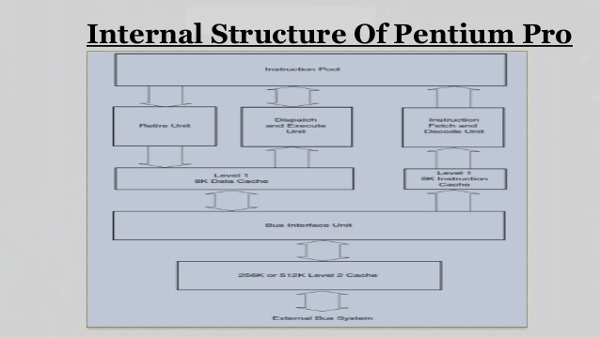
Internal Structure of the Pentium Pro

Slide 13
The Pentium Pro is structured differently than earlier microprocessors.
The system buses, which communicate to the memory and I/O, connect to an internal level 2 cache that is often on the main board in most other microprocessor systems.
The level 2 cache in the Pentium Pro is either 256K bytes or 512K bytes.
The bus interface unit (BIU) controls the access to the system buses through the level 2 cache, which is integrated in Pentium Pro. The BIU generates the memory address and control signals, and passes and fetches data or instructions to either a level 1 data cache or a level 1 instruction cache.
The instruction cache is connected to the instruction fetch and decode unit (IFDU). The IFDU contains three separate instruction decoders that decode three instructions simultaneously. Once decoded, the outputs of the three decoders are passed to the instruction pool, where they remain until the dispatch and execution unit or retire unit obtains them.
Also included within the IFDU is a branch prediction logic section that looks ahead in code sequences that contain conditional jump instructions. If a conditional jump is located, the branch prediction logic tries to determine the next instruction in the flow of a program.

Slide 14
Pentium Pro can process two integer instructions and one floating-point instruction simultaneously.
The dispatch and execute unit (DEU) retrieves decoded instructions from the instruction pool when they are complete, and then executes them.
Pentium Pro has a RU (Retire unit) which checks the instruction pool and removes decoded instructions that have been executed.

Slide 15
The Pentium Pro dispatch and execution unit (DEU).
Integer Unit
Jump Unit
Floating point unit
Integer Unit
Address generation unit
Address generation unit
Reservation Station (RS)
Instruction Pool

Slide 16
The Memory System of Pro
. The Pentium Pro uses a 64-bit data bus to address memory organized in eight banks that each contain 8G bytes of data. A
Additional memory is enabled with bit position 5 of CR4 and is accessible only when 2M paging is enabled.
2M paging is new to the Pentium Pro to allow memory above 4G to be accessed.
New to the Pentium Pro is a built-in error-correction circuit (ECC) that allows the correction of a one-bit error and the detection of a two-bit error.
To accomplish the detection and correction of errors, the memory system must have room for an extra 8-bit number that is stored with each 64-bit number.
The extra 8 bits are used to store an error-correction code that allows the Pentium Pro to automatically correct any single-bit error.

Slide 17
I/O System of Pro
Same as that of Pentium

Slide 18

System timing
Same as that of Pentium except that the $\overline{BRDY}$ signal in Pentium is now $\overline{TRDY}$ signal.

